Slide 1
Introduction to Cloud Infrastructure Provisioning in Azure with Terraform
Jason L. van Brackel
Sr. Solutions Architect Apprenda

Slide 2
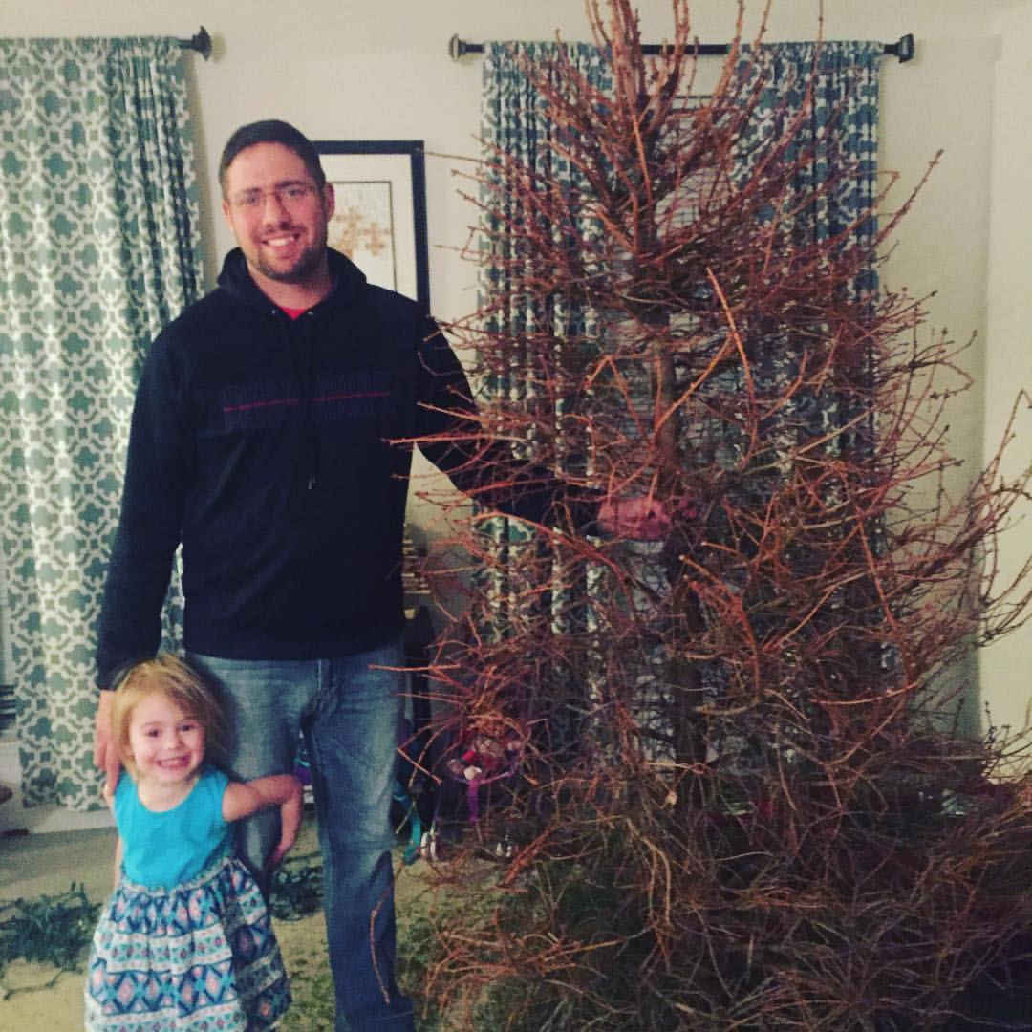

Jason L. van Brackel
Sr. Solutions Architect
@jasonvanbrackel
@k8sPhilly
morehuman.software

Slide 3

Agenda
What is Terraform?
Features
Use Cases
Why Terraform?
Demo

Slide 4
What is Terraform

Slide 5
What is Terraform
A tool with a simple API for managing infrastructure in via automation
  Building
  Changing
  Versioning

Slide 6
What is Terraform
Public Cloud
Azure
Google Cloud
AWS
Digital Ocean
PaaS and Private Cloud
Heroku
OpenStack
VMware vSphere
  And Many More

Slide 7
Features
Infrastructure as code
Execution Plans
Resource Graphs
Change Automation

Slide 8
Features
Infrastructure as code
Execution Plans
Resource Graphs
Change Automation

Slide 9
Features – Infrastructure as code
# Create a resource group
resource "azurerm_resource_group" "network" {
name = "production"
location = "West US"
}
# Create a virtual network within the resource group
resource "azurerm_virtual_network" "network" {
name = "production-network"
address_space = ["10.0.0.0/16"]
location = "${azurerm_resource_group.network.location}"
resource_group_name = "${azurerm_resource_group.network.name}"
subnet {
name = "subnet1"
address_prefix = "10.0.1.0/24"
}
}

Slide 10
Features – Execution Plans
+ azurerm_resource_group.intro_to_terraform-rg
id: <computed>
location: "eastus"
name: "intro_to_terraform-rg"
tags.%: <computed>
+ azurerm_virtual_network.network
id: <computed>
address_space.#: "1"
address_space.0: "10.0.0.0/16"
location: "eastus"
name: "introToTerraformNetwork"
resource_group_name: "intro_to_terraform-rg"
subnet.#: "1"
subnet.1472110187.address_prefix: "10.0.1.0/24"
subnet.1472110187.name: "subnet1"
subnet.1472110187.security_group: ""
tags.%: <computed>
Plan: 2 to add, 0 to change, 0 to destroy.

Slide 11
Use Cases
Multi-Tier Applications
Disposable Environments
Self-Service Clusters
Software Defined Networking
  https://docs.microsoft.com/en-us/windows-server/networking/sdn/software-defined-networking
  https://docs.microsoft.com/en-us/windows-server/get-started/whats-new-in-windows-server-1709

Slide 12
Why Terraform?
Provider agnostic
Cross-Platform compatible
Extensible
Simple

